Slide 1
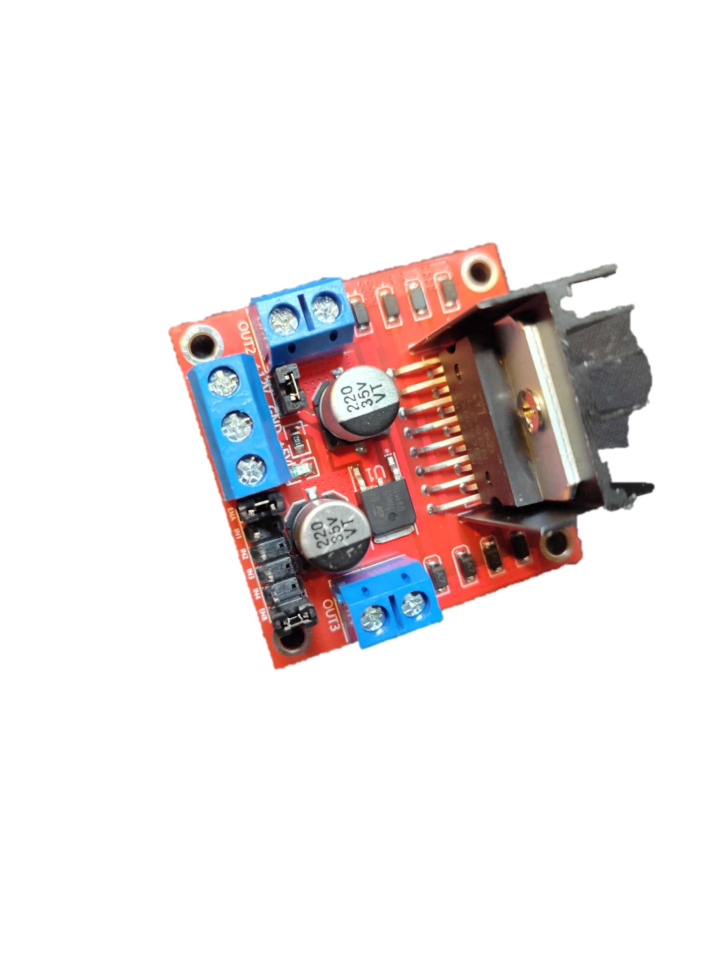
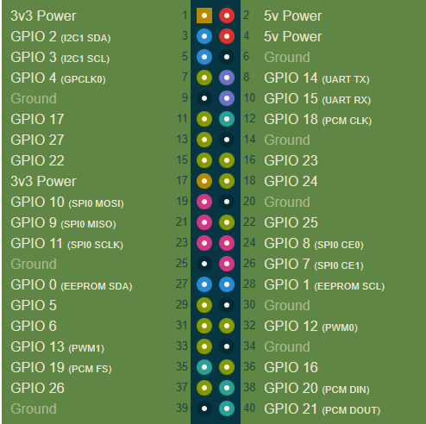

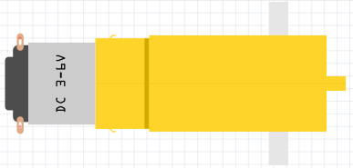
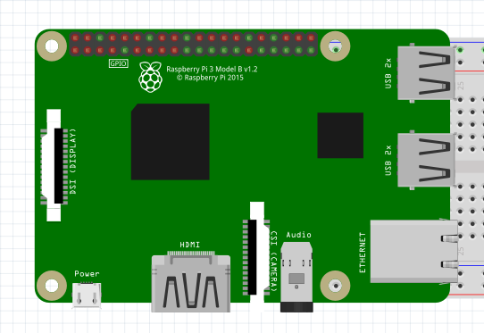
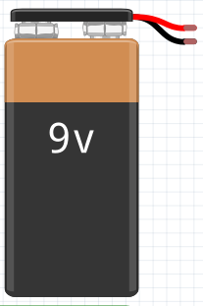
Notes:
This one is good for the stemulate santa ana workshop 3/13/26 (only difference is the switched pairs of wires that control motor direction)

Slide 2
Notes:
Original 2025 Summer Robotics Camp Design

